Slide 1
Coupled atmosphere-ocean simulation on hurricane forecast
Yingjian Chen
May 10, 2016

Slide 2
Introduction
Hurricane wind field has significant impacts on ocean physics:
(1) Sensible and latent heat are lost to the atmosphere
(2) cyclonic motion of hurricane intensifies the oceanic cyclonic circulation, maximizing upwelling and deepening the mixed layer
(3) strong winds generates extreme sea surface waves and enhances the turbulent entrainment.
As a result, the sea surface temperature (SST) is lowered.
Negative feedback may occur between the SST response and hurricane intensity
Hurricane motion is a strongly coupled process
To investigate the atmosphere-ocean coupled simulation on hurricane forecast
Notes:
As is known, hurricane wind field has significant impacts on ocean physics
Sensible and latent heat are transferred to the atmosphere to provide energy for hurricane intensification.
cyclonic motion of hurricane intensifies the oceanic cyclonic circulation, maximizing upwelling and deepening the mixed layer
And the most important one, strong winds generates extreme sea surface waves and enhances the turbulent entrainment.
As a result, colder water in the deeper layer in the ocean rises to the surface and the sea surface temperature is lowered.
Negative feedback from ocean response will occur. Lower SST may reduce the heat flux from ocean to air and impede the hurricane intensificaition.
In summary, hurricane motion is a strongly coupled process
So my research on the current stage is to investigate the atmosphere-ocean coupled simulation for hurricane forecast

Slide 3
COAWST V3.2 (Coupled-Ocean-Atmosphere-Wave-Sediment Transport Modelling)
Atmosphere – Weather Research and Forecast (WRF) V3.7.1
Ocean – Regional Ocean Modelling System (ROMS) svn 748
Wave – Simulating Waves Nearshore (SWAN) V40.91A
Sediment Transport – Community Sediment Transport Modelling
System (CSTMS)
Coupler – Model Coupling Toolkit (MCT) V2.6.0
I only used the WRF—ROMS coupling.
Notes:
The model I used is COAWST, version 3.2.
It has coupled a weather forecast model WRF version 3.7.1, an ocean model ROMS, a sea surface wave model SWAN and a sediment transport model.
It used the coupler called MCT for data exchange between every two models.
This model was used by many researchers, among them, a majority used it for hurricane research.
At the current stage I only used the WRF-ROMS coupling and ignored the effects of sea surface wave.

Slide 4
Data exchange
WRF
WRP
···
Momentum
Latent heat
SST
Sensible heat
Short wave
ROMS
···
Long wave
ROMS
Notes:
Every coupling interval in the simulation process, WRF sends Momentum flux, latent and sensible heat flux, short and long wave radiation to ROMS, and ROMS sends the sea surface temperature to WRF at the same time. Then integrate forward individually until the next coupling time step.

Slide 5
Model Configuration
WRF V3.7.1
3 nesting domains:
D01 (304*274, 27 km)
D02 (403*382, 9 km)
D03 (403*403, 3 km)-vortex
following
Vertical levels = 43
Initial condition: interpolated from the EnKF ensemble mean output created by Green and Zhang (2013)
Boundary condition: GFS
Notes:
I used three nesting domains in WRF. The horizontal grid resolution is 27, 9, 3 km respectively. Vertical direction uses 43 levels.
The initial condition was interpolated from the EnKF ensemble mean output created by Green and Zhang (2013)
Lateral boundary condition use GFS

Slide 6
Model Configuration
ROMS
1 domains (290*500, 5km)
Vertical levels = 30
Bathymetry: GEBCO
Forcing field:
meteo forcing (from WRF)
astronomical tide (extracted from OSU-OTPS model, 11 tidal components).
Initial condition: HYCOM
Boundary condition: HYCOM
Notes:
The ocean model, ROMS, use 1 domain with the horizontal grid resolution of 5km. Two types of forcing field are set. The meteo forcing is from WRF output and the astronomical tide is extracted from OTPS model with 11 tidal components. Initial and boundary condition are both interpolated from the global circulation model HYCOM.

Slide 7
Run ROMS for 10 days in advance (0000 UTC 16 Aug to 0000 UTC 26 Aug) to yield stable state fields for atmosphere-ocean coupling case.
Coupling Setup
Integration period: 0000 UTC 26 Aug — 0000 UTC 31 Aug 2005
Time step: WRF—60 sec for D01, ROMS—30 sec
Data exchange — 15 min
Notes:
Before coupling, only run ROMS for 10 days in advance to yield stable circulation fields
The coupling model was integrated from Aug 26 to Aug 31 2005
Time step for WRF D01 and ROMS are 60s and 30s respectively
Data were exchanged every 15 min

Slide 8
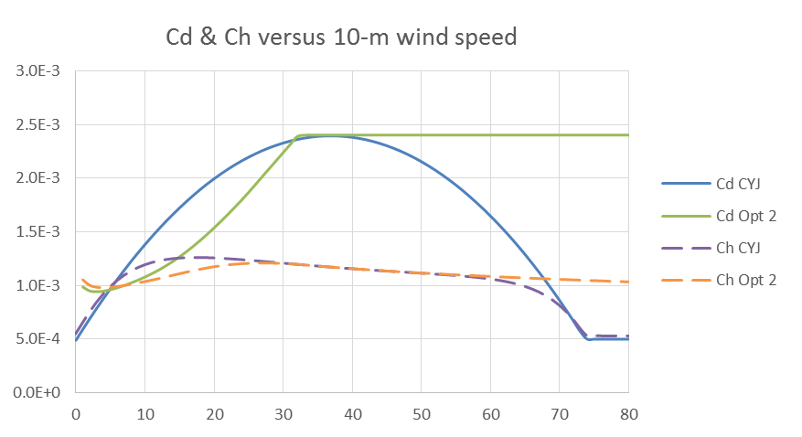
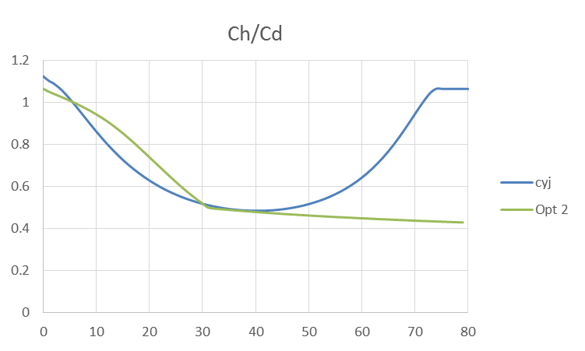
Exchange coefficient for wind drag:
Ex. coefficient for sensible heat:
Chen:
Opt 2:
Ex. coefficient for latent heat:
Notes:
Exchange coefficients are very important parameters for hurricane simulation. They are directly related to hurricane intensity. Here I choose two options for wind drag coefficient. The first one is option 2 in WRFV3.7.1. The drag coefficient levels off when u10 is larger than 30 m/s. the second one considered the sea spray effect on the momentum transfer and predict the drag coefficient decreasing with the increasing wind speed. The method for computing the coefficient of sensible heat Ch and latent heat Cq are set the same. Cd Ch and the ratio of Ch to Cd are plot in the figure

Slide 9
Non-Coupled Case
Notes:
Here is the result where WRF is not coupled with ROMS. We can see that the simulated tracks are close to the best track. The case with Chen’s drag formula propagates along with the best track after 36 hours since initialization but slower than the best track. Without coupled with the ocean model, Opt 2 predicts more satisfying hurricane intensity and maximum wind speed. The intensity metrics predicted by Chen’s formula are stronger than best track result.

Slide 10
Coupled Case
Notes:
After coupled with the ocean model, the hurricane tracks are not much different from the Non-Coupled one. This is because the track position is mainly determined by large-scale steering flows. However, the intensity of both coupled case is much weaker than reality.

Slide 11
10-m Wind Speed
Non Coupled
Coupled
Opt 2
Chen
Notes:
We can see in the Hovmoller diagram that radial wind velocity (the white line) in coupled case is a little smaller than that in the Non-Coupled case, but the tangential wind velocity is much weaker

Slide 12
Heat Flux
Non-Coupled
Coupled
Latent heat
Sensible heat
Latent heat
Sensible heat
Opt 2
Chen
Notes:
And the heat flux in the coupled case is almost half of the Non-Coupled one

Slide 13
Sea Surface Temperature Anomaly
Opt 2
Chen
Notes:
Then the sea surface temperature is investigated. Plotted in the figure is the SST anomaly between several simulation times and the initial time. The maximum SST decreasing is up to 6 degree Celsius, which is the main contributions to the weak hurricane intensity.

Slide 14
Discussion
When coupled with the ocean model, the ocean response have a negative feedback to the hurricane intensity
The cooling effect is exaggerated
Research Plan
Fix the problem discussed above and compare the state field of the ocean with the observation
Investigate the sensitivity of SST, wind drag evaluation method on the hurricane intensity
Assess the applicability of the coupled model on the hurricane forecast
Notes:
When the weather forecast model is coupled with the ocean model, the ocean response have a negative feedback to the hurricane, its intensity will become weaker than the case without coupling.
But in this case, the cooling effect is exaggerated, I think it is partly due to the parameterization of the turbulent mixing in strong winds.
Fix the problem discussed above and compare the state field of the ocean with the observation
Investigate the features of the coupled system, and the sensitivity of SST, wind drag evaluation method on the hurricane intensity
Assess the applicability of the coupled model on the hurricane forecast

Slide 15
Thank you!

